Slide 1

Analysis on movies data
Sachin Jalan

Slide 2
Questions that matter
In last few years, the film industry has become more popular than ever. In 2018, movies made total income around $ 41.7 billion throughout the world. But what movies make the most money at the box office?
How much does a director matter?
Do ratings and metascore mean anything? Do certain actors and/or genre amount to good revenues for producers?
We need to help Webflix – an OTT platform decide which kind of original movies and artists can fetch the maximum possible revenue for them and also good viewership.

Slide 3
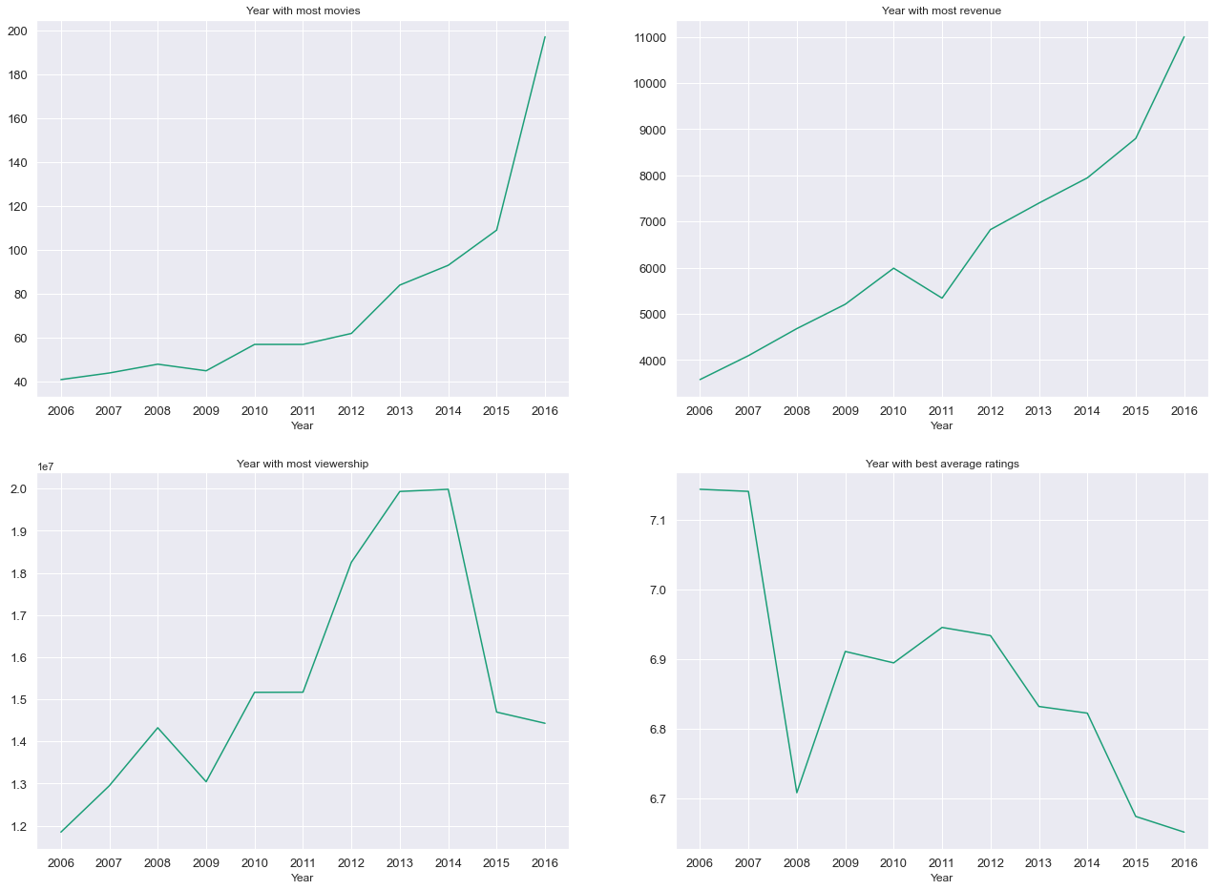
Movies over the years
Revenue increasing.
No. of movies increasing.
Viewership falling
Ratings falling

Slide 4
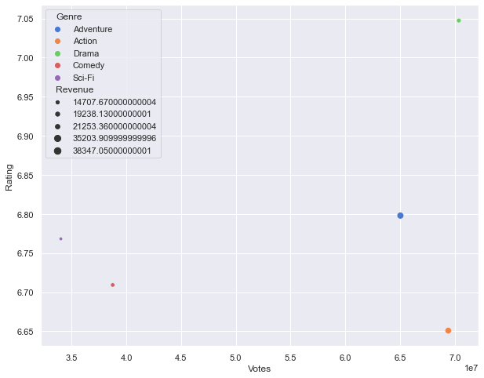
Genres ranking
Adventure and Action – good revenue, average ratings.
Adventure – satisfactory rating, good revenue, good viewership.
Adventure, Action, Drama, Comedy and Sci-Fi genres to be considered.
Animation can be experimented with.

Slide 5
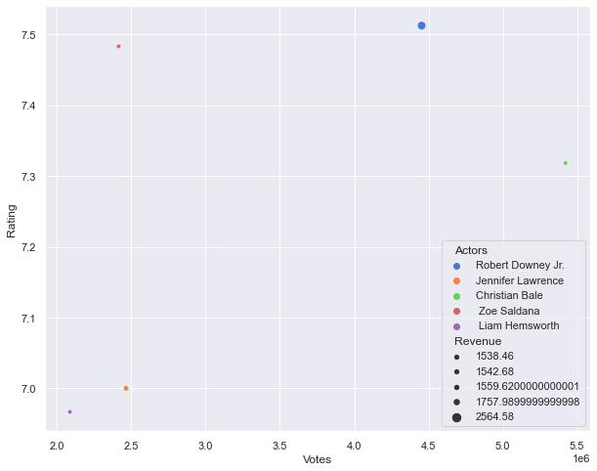
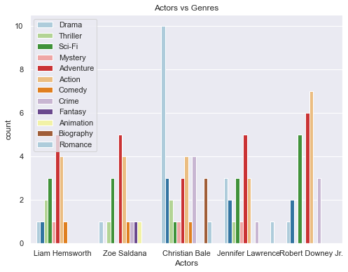
Actors ranking
Robert Downey Jr. – good revenue, high rating, good enough viewership. Can be cast in Action, Adventure, Sci-Fi.
Jennifer Lawrence – good revenue, low viewership due to few movies. Can be cast in Adventure, Romance, Sci-Fi, Action.
Christian Bale, Zoe Saldana, Liam Hemsworth good candidates. Christian Bale good for Drama, Action and Crime genre.

Slide 6
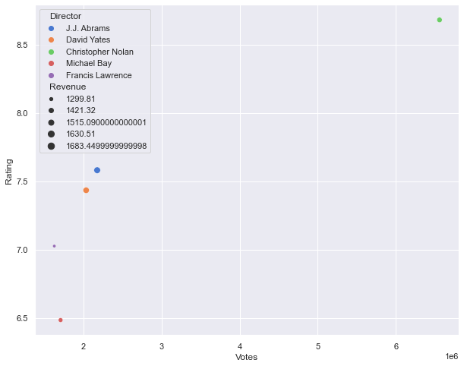
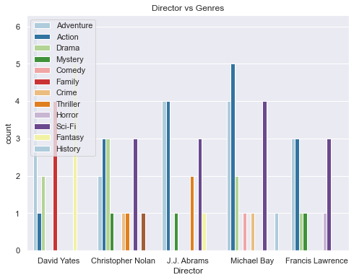
Directors ranking
Christopher Nolan – great ratings and viewership. Revenue not bad. Good for Action, Drama, Sci-Fi.
J.J Adams, David Yates good revenue figures and ratings. Viewership can improve. J.J good for Action, Adventure and Sci-Fi.
David good for Family movies, History and Fantasy.

Slide 7
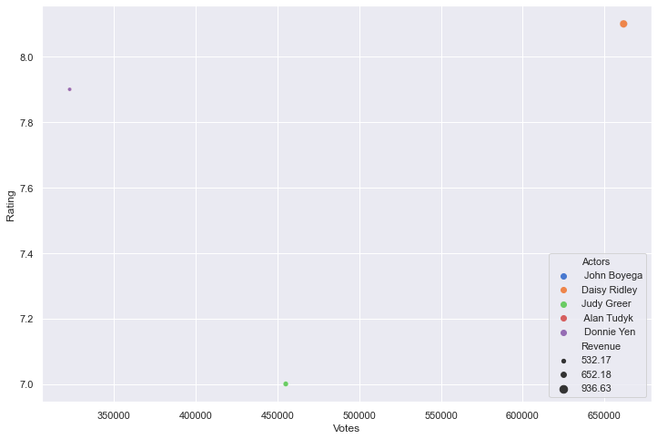
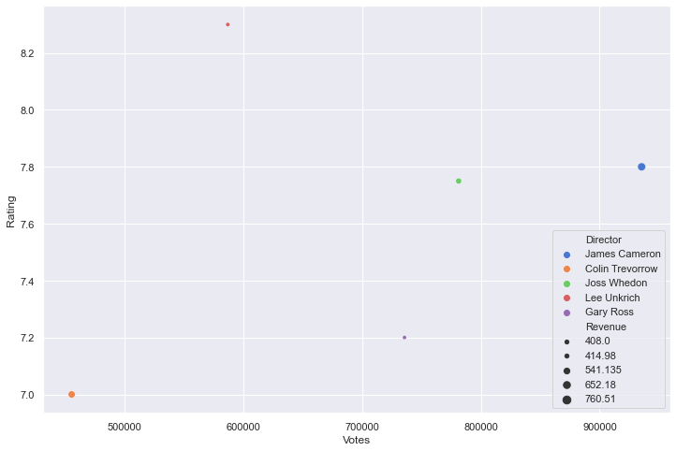
Actors & directors to lookout for
Daisy Ridley
Judy Greer
Donnie Yen
James Cameron
Colin Trevorrow
Joss Whedon

Slide 8
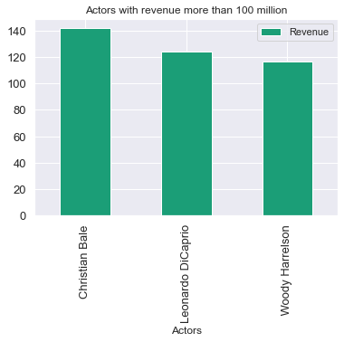
Consistent performance
Actors with more than 8 movies from 2006-2016.
Avg. Revenues greater than 100 million.

Slide 9

THANK YOU!

